Slide 1

QUEUE
MK STRUKTUR DATA
INFORMATIKA INSTITUT TEKNOLOGI TELKOM SURABAYA

Slide 2
QUEUE
Like Stack, Queue is a linear structure which follows a particular order in which the operations are performed. The order is First In First Out (FIFO). A good example of queue is any queue of consumers for a resource where the consumer that came first is served first.

Slide 3
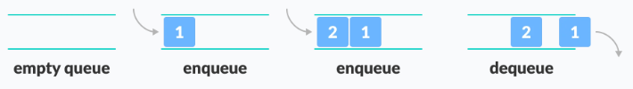
QUEUE

Slide 4
Basic Operations of Queue
A queue is an object (an abstract data structure - ADT) that allows the following operations:
Enqueue: Add an element to the end of the queue
Dequeue: Remove an element from the front of the queue
IsEmpty: Check if the queue is empty
IsFull: Check if the queue is full
Peek: Get the value of the front of the queue without removing it

Slide 5
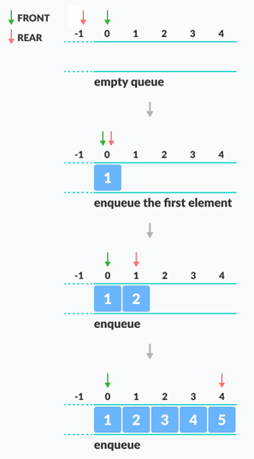
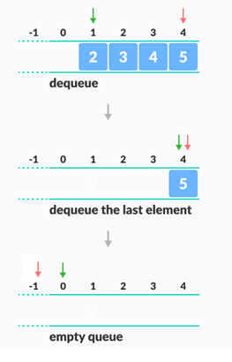

Slide 6

Inisialisasi
Array size dengan jumlah 6
Inisialisasi front 0 dan rear -1
ItemCount berfungsi untuk cek kondisi array

Slide 7
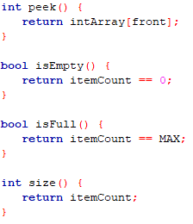
Peek, isEmpty, isFull, size
Fungsi dengan tipe data bool, membutuhkan library #include <stdbool.h>
Return berupa true / false

Slide 8
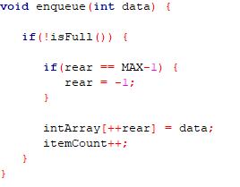
Enqueue
Cek kondisi (isFull)
Apabila kondisi rear sudah berada di index terakhir, maka rear diubah bernilai -1
Setiap akan menginputkan data, rear ditambah 1 terlebih dahulu.

Slide 9
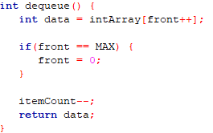
Dequeue

Slide 10
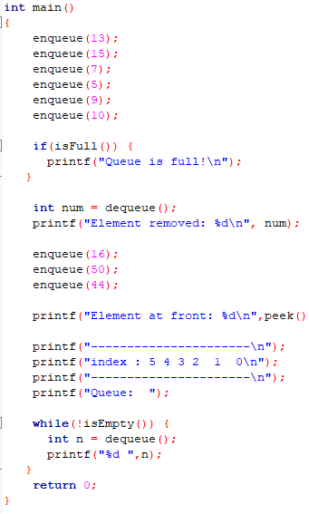
Main

Slide 11
Tugas
Implementasi Stack dan Queue dengan Struct
Operasi stack yang harus ada : push(), pop(), peek()
Operasi queue yang harus ada : enqueue(), dequeue() dan pee()
Struct KTP : nama lengkap, usia
KTP.nama = “Nama Depan”;
KTP.tanggal = 23
KTP.nama = “Nama Tengah”;
KTP.bulan = 23
KTP.nama = “Nama Belakang”;
KTP.tahun = 23

Slide 12
Alur Program
Push/enqueue struct KTP 1
Push/enqueue struct KTP 2
Push/enqueue struct KTP 3
Peek stack/queue
Pop/dequeue stack/queue
Print data nama dan tanggal yg di pop/dequeue
Pop/dequeue stack/queue
Print data nama dan bulan yg di pop /dequeue
Pop/dequeue stack/queue
Print data nama dan tahun yg di pop /dequeue

Slide 13
Pengumpulan
Buat video recording isinya :
Demo program (outputnya, sesuai dg alur program main)
Penjelasan kode
Video diunggah di youtube masing2, di setting public agar bs dilihat org lain
Harus Nampak wajah di video (seperti presentasi)
Link video dikumpulkan di e-learning
Deadline menuliskan link Minggu 08.00 (24 April 2022)

